Slide 1
Unclonable Secret Keys
Marios Georgiou, City University of New York
CORELab Seminar

Slide 2


No-Cloning Theorem
For any quantum algorithm A, there is a quantum state that A cannot clone.
Classically, we can always copy a bit-string.
Notes:
Mention the distinction in colors!!
Worst case statement, but it also holds in the average case, in the sense that for a random quantum state of n qubits, the probability of cloning it within a constant distance is negligible.

Slide 3

Unclonability of Useful Quantum States?
Useful:
It may have more structure.
It may come together with some auxiliary classical information, e.g., a verification key (Quantum Money)
Question
How much can we strengthen the No-Cloning Theorem?

Slide 4



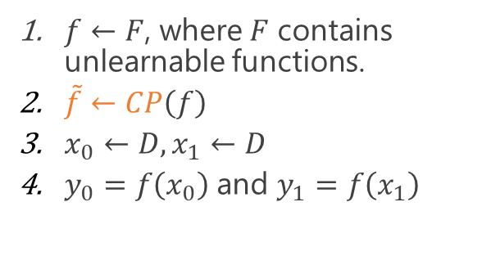

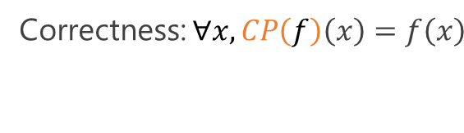





Software Copy-Protection [Aar09, ALZ20]
Correctness: $∀x,CP\left(f\right)\left(x\right)=f\left(x\right)$
$$y_{0}$$
$$\tilde{f_{0}}$$
$$D$$
$$x_{1}$$
$$\tilde{f}$$
$$x_{0}$$
$$\tilde{f_{1}}$$
$f←F$, where $F$ contains
unlearnable functions.
$\tilde{f}←CP\left(f\right)$
$x_{0}←D, x_{1}←D$
$y_{0}=f\left(x_{0}\right)$ and $y_{1}=f\left(x_{1}\right)$
$$y_{1}$$
Notes:
Aaronson, Liu, Zhang
Given the quantum state, one cannot generate two states that both can be used to evaluate the function.
Copy protection is a stronger form of obfuscation. If I could learn the function from quantum state then I could make copies of it. Handwavy argument but gives a flavor of what copy protection is.

Slide 5

Generic Software Copy-Protection Results
Theorem [ALZ20]: There is a generic software copy-protection for any unlearnable function relative to a classical oracle.
Theorem [ALP20]: There is no generic software copy-protection in the plain model under LWE.
Similarly to impossibility of VBB, [ALP20] holds for a contrived class of functions.
This thesis
Are there cryptographic objects whose secret key operation is unclonable?
Notes:
Aaronson, Liu, Zhang: By modifying the public-key quantum money scheme from hidden subspaces.
Ananth, La Placa: By modifying the impossibility result of VBB obfuscation.
If we had a generic copy protection, we could build unclonable decryption by copy protecting the decryption algorithm.

Slide 6








Security Definitions Pattern
$${sk}_{0}$$
$${sk}_{0}$$
$${sk}_{1}$$
$$pk,sk$$
$${sk}_{1}$$
$$pk$$
$$crs$$
Honestly
Dishonestly
Notes:
Dishonestly Generated Keys was introduced by Zhandry

Slide 7







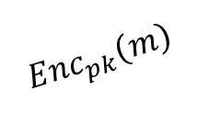

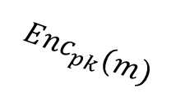





Motivation: Traitor Tracing [CFN94]
$$Enc_{pk}\left(m\right)$$
$${sk}_{1}$$
$$Enc_{pk}\left(m\right)$$
$${sk}_{2}$$
$$Enc_{pk}\left(m\right)$$
$$Enc_{pk}\left(m\right)$$
$${sk}_{3}$$
$${sk}_{4}$$
Notes:
Media provider
What happens if some people decide to broadcast their secret keys? The cryptographic area of traitor tracing (Chor, Fiat, Naor) aims to not prevent, because this is impossible, but manage to track down the malicious parties.

Slide 8




Leakage Detection
$$sk$$
$$\left(pk,sk\right)$$
Notes:
The key pair can be for a signature, an encryption or any other cryptographic primitive.
We would like to have a mechanism to verify that a key has leaked.
Hard classically in some settings. For example if it a decryption key then the adversary may never get detected.

Slide 9

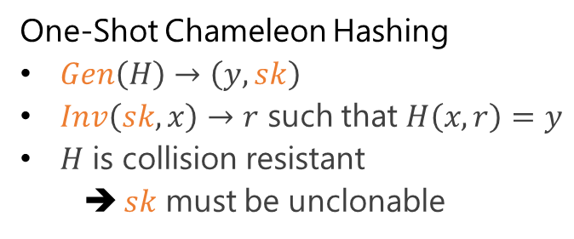

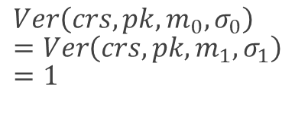

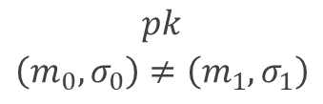
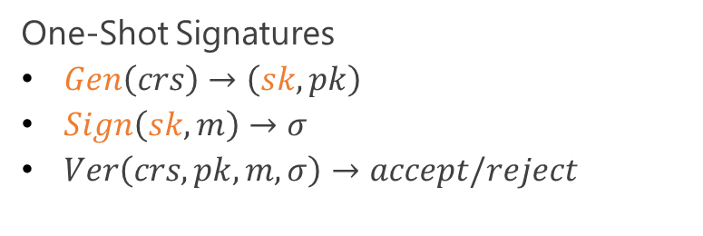


One-Shot Primitives [AGKZ20]
One-Shot Chameleon Hashing
$Gen\left(H\right)→\left(y,sk\right)$
$Inv\left(sk,x\right)→r$ such that $H\left(x,r\right)=y$
$H$ is collision resistant
  $sk$ must be unclonable
One-Shot Signatures
$Gen\left(crs\right)→\left(sk,pk\right)$
$Sign\left(sk,m\right)→σ$
$Ver\left(crs,pk,m,σ\right)→accept/reject$
$$crs$$
$$pk$$
$$\left(m_{0},σ_{0}\right)≠\left(m_{1},σ_{1}\right)$$
$$H\left(x,r\right)=y$$
$$Ver\left(crs,pk,m_{0},σ_{0}\right)=Ver\left(crs,pk,m_{1},σ_{1}\right)=1$$
$$m$$
$$σ$$
$$pk$$
Notes:
You remember from proposal.
Amos, Kiayias, Zhandry
CRS necessary, same reason that we need a CRS for CRHF.
Two things to notice:
Adversary gets to pick the public key.
Communication with the challenger is purely classical.

Slide 10






Proofs Of Quantumness [BCM+18, AGKZ20]
$$crs$$
$$pk$$
$$m$$
$$σ$$
Notes:
Zvika Brakerski ; Paul Christiano ; Urmila Mahadev ; Umesh Vazirani ; Thomas Vidick
Classical verifier and quantum prover. The prover wants to convince the verifier that it is quantum.
Analyze security. Mention that the underlying assumption does not even need to be post-quantum.

Slide 11








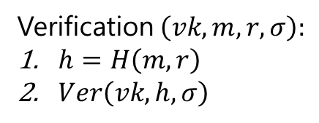
Signature Delegation (Hash then Sign) [AGKZ20]
$$h$$
$$σ=Sign(sk,h)$$
$$sk,vk$$
$$sk$$
Verification $\left(vk,m,r,σ\right):$
$h=H\left(m,r\right)$
$Ver\left(vk,h,σ\right)$
$$r←Inv\left(sk,m\right)$$
Notes:
Alice has a secret key public key pair for a classical signature scheme that is unforgeable under chosen message attacks. She wishes to delegate to Bob the power of signing but only once.
Alice does not have to be quantum.

Slide 12


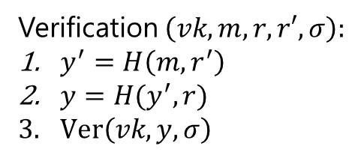








Signature Delegation (Hash then Sign)
$$y$$
$$y′$$
$$σ=Sign(sk,y)$$
$$σ,r$$
$$sk,vk$$
$$sk$$
$$sk′$$
$$r←Inv\left(sk,y′\right)$$
Verification $\left(vk,m,r,r′,σ\right):$
$y^{′}=H\left(m,r^{′}\right)$
$y=H(y^{′},r)$
$Ver\left(vk,y,σ\right)$
$$r′←Inv\left(sk′,m\right)$$

Slide 13





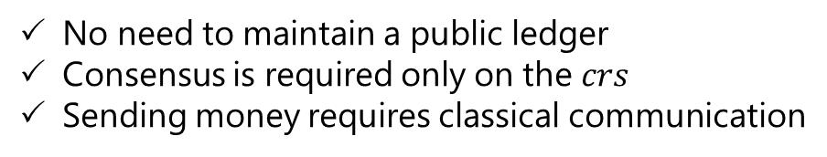


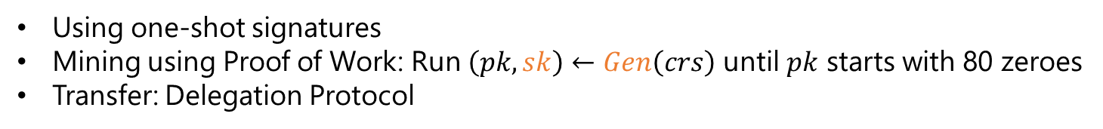





Blockchain-less Cryptocurrency with Classical Communcation
Using one-shot signatures
Mining using Proof of Work: Run $\left(pk,sk\right)←Gen\left(crs\right)$ until $pk$ starts with 80 zeroes
Transfer: Delegation Protocol
$${pk}_{1}$$
$${pk}_{2}$$
$$σ_{1}←Sign\left({sk}_{0},{pk}_{1}\right)$$
$$σ_{2}←Sign\left({sk}_{1},{pk}_{2}\right)$$
$${pk}_{0}$$
$${pk}_{0},σ_{1},{pk}_{1}$$
$${pk}_{0},{sk}_{0}$$
$${pk}_{1},{sk}_{1}$$
$${pk}_{2},{sk}_{2}$$
Improvements:
Add SNARK to keep size of the chain small
Add ZK to ensure privacy
No need to maintain a public ledger
Consensus is required only on the $crs$
Sending money requires classical communication

Slide 14

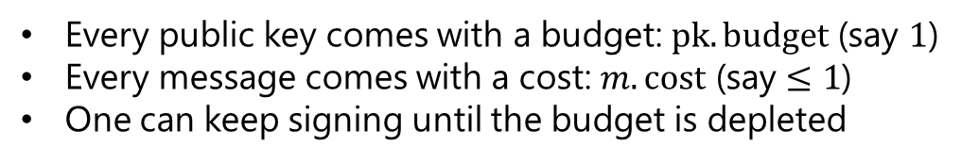







Budget Signatures
Every public key comes with a budget: $pk.budget$ (say $1$)
Every message comes with a cost: $m.cost$ (say $≤1$)
One can keep signing until the budget is depleted
$$pk,σ←Sign\left(sk,\left({pk}_{0},{pk}_{1}\right)\right)$$
$$pk,sk$$
$${pk}_{0},σ_{0}←Sign\left({sk}_{0},m\right)$$
$${pk}_{0},{sk}_{0}$$
$${pk}_{1},{sk}_{1}$$
$${pk}_{1},σ_{1}←Sign({sk}_{1},\left({pk}_{10},{pk}_{11}\right))$$
$${pk}_{10},{sk}_{10}$$
$${pk}_{11},{sk}_{11}$$
Can use this in our cryptocurrency to spend fractions of a coin.
Notes:
Using this delegation mechanism we can do more things such as budget signatures.
Use a form of Merkle trees.
We can add this to our cryptocurrency to spend fractions of our coin.

Slide 15


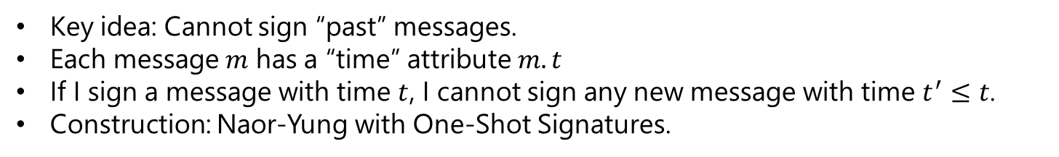




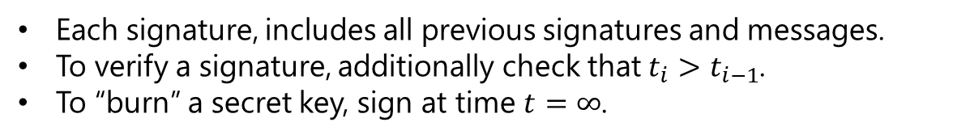
Ordered Signatures [AGKZ20]
Key idea: Cannot sign “past” messages.
Each message $m$ has a “time” attribute $m.t$
If I sign a message with time $t$, I cannot sign any new message with time $t^{′}≤t$.
Construction: Naor-Yung with One-Shot Signatures.
$$pk_{1},σ_{1}←Sign\left(sk_{1},(pk_{2},m_{2},t_{2})\right)$$
$$pk_{0},σ_{0}←Sign\left(sk_{0},(pk_{1},m_{1},t_{1})\right)$$
$$pk_{1},{sk}_{1}$$
$$pk_{0},{sk}_{0}$$
$$pk_{2},{sk}_{2}$$
Each signature, includes all previous signatures and messages.
To verify a signature, additionally check that $t_{i}>t_{i−1}$.
To “burn” a secret key, sign at time $t=∞$.
Notes:
I don’t give the formal definition here, but this is the main idea.

Slide 16


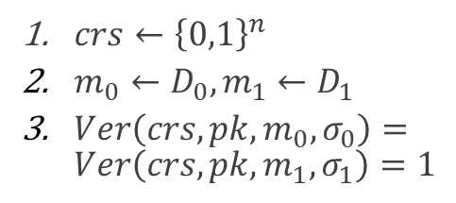






Single-Signer Signatures [AGKZ20]
One can sign arbitrarily many messages.
$$σ_{0}$$
$${sk}_{0}$$
$$pk,D_{0},D_{1}$$
$$crs$$
$$m_{1}$$
$$m_{0}$$
$${sk}_{1}$$
$crs←{\left\{0,1\right\}}^{n}$
$m_{0}←D_{0}, m_{1}←D_{1}$
$Ver\left(crs,pk,m_{0},σ_{0}\right)=Ver\left(crs,pk,m_{1},σ_{1}\right)=1$
$$σ_{1}$$
Theorem: Ordered Signatures are Single-Signer Signatures.
Notes:
If there was a way to generate two keys then we cannot maintain an order in the time tags.

Slide 17
More Applications
Public-coin proofs of min-entropy
Delayed Signatures
  One can sign one message every minute
  Using proofs of sequential work
Notes:
Probably there are many more applications. For example, one thing that one may be interested in looking into, is how to achieve consensus.

Slide 18
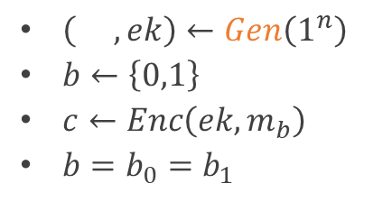

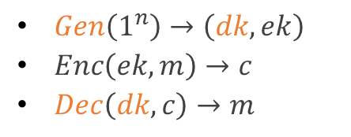







Single Decryptor Secret-Key Encryption [GZ20]
$Gen\left(1^{n}\right)→\left(dk,ek\right)$
$Enc\left(ek,m\right)→c$
$Dec\left(dk,c\right)→m$
$$b_{0}$$
$${dk}_{0}$$
$$c$$
$$m_{0},m_{1}$$
$$c$$
$${dk}_{1}$$
$\left( ,ek\right)←Gen\left(1^{n}\right)$
$b←\left\{0,1\right\}$
$c←Enc\left(ek,m_{b}\right)$
$b=b_{0}=b_{1}$
$$dk$$
$$b_{1}$$
Selective Security: Adversary picks $m_{0},m_{1}$ before seeing $dk$.
Notes:
Emphasize Secret key
Notice that the adversaries never get to see the encryption key. This is why it is secret key.
We will show that this is equivalent to unclonable encryption as we will define now.
Information theoretic definition. We do not impose any computational restrictions. We can hope for such definitions because there is no brute force attack.

Slide 19
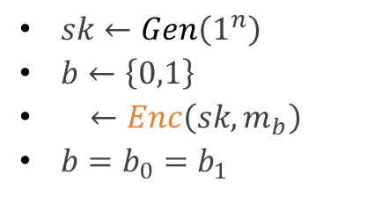

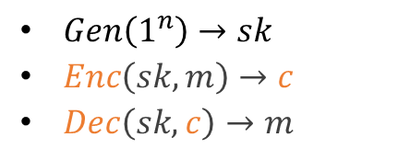




Unclonable Encryption [BL19]
$Gen\left(1^{n}\right)→sk$
$Enc\left(sk,m\right)→c$
$Dec\left(sk,c\right)→m$
$$b_{0}$$
$$c_{0}$$
$$sk$$
$$m_{0},m_{1}$$
$$sk$$
$$c_{1}$$
$sk←Gen\left(1^{n}\right)$
$b←\left\{0,1\right\}$
$←Enc\left(sk,m_{b}\right)$
$b=b_{0}=b_{1}$
$$b_{1}$$
$$c$$
Theorem [BL19]: Unclonable Encryption exists in the ROM if the adversaries are not entangled.
Notes:
Broadbent, Lord

Slide 20
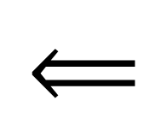
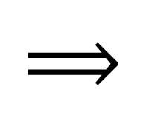
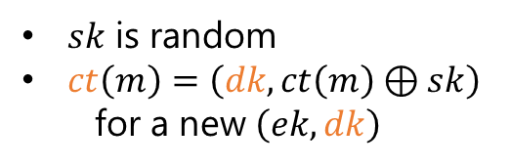
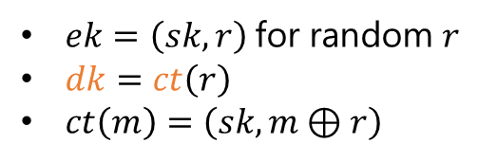
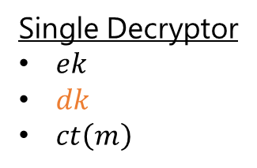
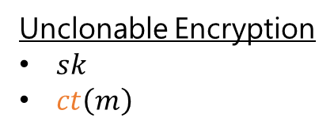
Equivalence [GZ20]
Theorem [GZ20]: Unclonable Encryption exists if and only if selectively secure single decryptor secret key encryption exists.
Corollary: Selectively secure single decryptor encryption exists in the ROM if the adversaries are not entangled.
Unclonable Encryption
$sk$
$ct\left(m\right)$
Single Decryptor
$ek$
$dk$
$ct\left(m\right)$
$$⟹$$
$ek=\left(sk,r\right)$ for random $r$
$dk=ct\left(r\right)$
$ct\left(m\right)=\left(sk,m⊕r\right)$
$sk$ is random
$ct\left(m\right)=\left(dk,ct\left(m\right)⊕sk\right)$
  for a new $\left(ek,dk\right)$
$$⟸$$
Notes:
And the proof shows that we get the same kind of relationship between adversaries.
I have simplified some notation, but it may be slightly confusing. Explain orange vs black $ct$.

Slide 21



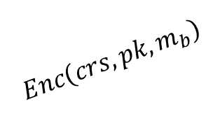
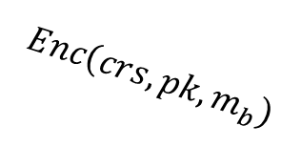

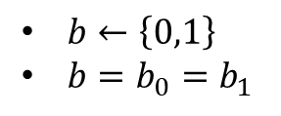


Public Key with Dishonest Key Generation
$${sk}_{0}$$
$$Enc\left(crs,pk,m_{b}\right)$$
$$b_{0}$$
$$crs$$
$$pk,m_{0},m_{1}$$
$${sk}_{1}$$
$$Enc\left(crs,pk,m_{b}\right)$$
$b←\left\{0,1\right\}$
$b=b_{0}=b_{1}$
$$b_{1}$$
Notes:
Hide crs

Slide 22
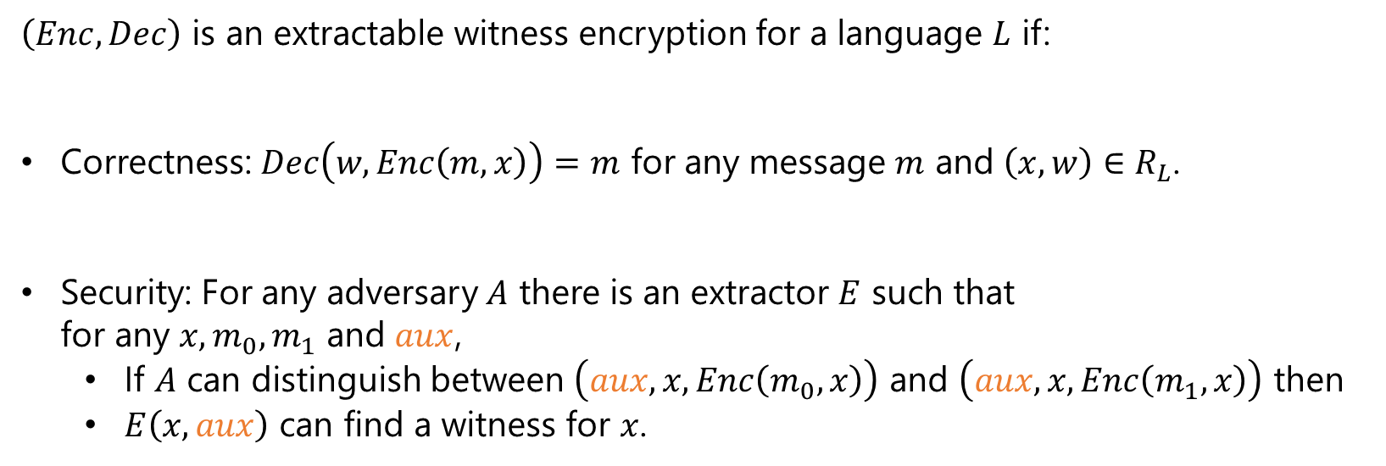
Witness Encryption [GGSW13, GKPVZ13]
$\left(Enc,Dec\right)$ is an extractable witness encryption for a language $L$ if:
Correctness: $Dec\left(w,Enc\left(m,x\right)\right)=m$ for any message $m$ and $\left(x,w\right)∈R_{L}$.
Security: For any adversary $A$ there is an extractor $E$ such that
for any $x,m_{0},m_{1}$ and $aux$,
  If $A$ can distinguish between $\left(aux,x,Enc\left(m_{0},x\right)\right)$ and $\left(aux,x,Enc\left(m_{1},x\right)\right)$ then
  $E\left(x,aux\right)$ can find a witness for $x$.
Notes:
Garg, S., Gentry, C., Sahai, A., Waters, B.
Goldwasser, S., Kalai, Y.T., Popa, R.A., Vaikuntanathan, V., Zeldovich, N.
No generation algorithm.

Slide 23
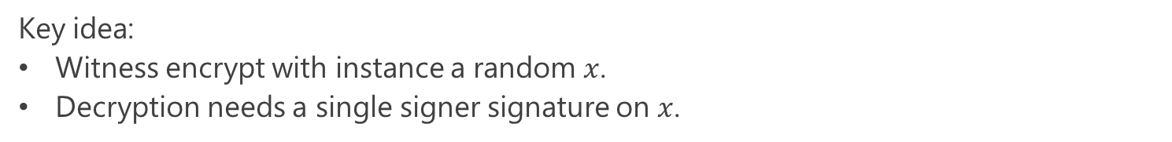
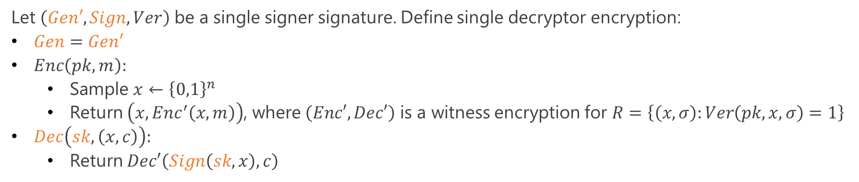
Construction
Key idea:
Witness encrypt with instance a random $x$.
Decryption needs a single signer signature on $x$.
Let $\left(Gen′, Sign, Ver\right)$ be a single signer signature. Define single decryptor encryption:
$Gen=Gen′$
$Enc\left(pk,m\right):$
  Sample $x←{\left\{0,1\right\}}^{n}$
  Return $\left(x,{Enc}^{′}\left(x,m\right)\right)$, where $\left(Enc′,Dec′\right)$ is a witness encryption for $R=\left\{\left(x,σ\right):Ver\left(pk,x,σ\right)=1\right\}$
$Dec\left(sk,\left(x,c\right)\right):$
  Return $Dec′\left(Sign\left(sk,x\right),c\right)$
Theorem: If an adversary can decrypt, then there is an extractor that retrieves a signature.
Notes:
Security: If there was a way for these two adversaries to predict the bit, then the corresponding extractors would be able to sign the randomness so we would break the single signer property.

Slide 24


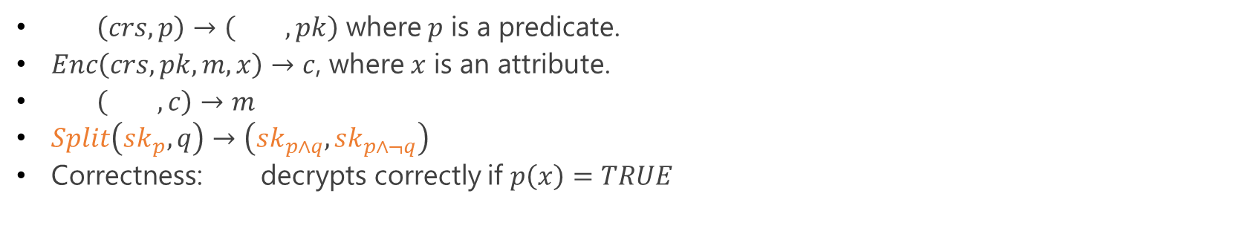


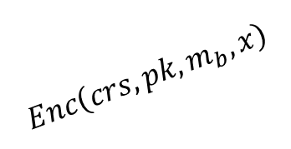
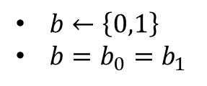

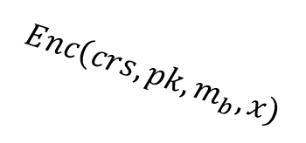






Attribute Based Encryption
Single Decryptor
Splittable
$${sk}_{p}$$
$\left(crs,p\right)→\left( ,pk\right)$ where $p$ is a predicate.
$Enc\left(crs,pk,m,x\right)→c$, where $x$ is an attribute.
$\left( ,c\right)→m$
$Split\left(sk_{p},q\right)→\left({sk}_{p∧q},{sk}_{p∧¬q}\right)$
Correctness: decrypts correctly if $p\left(x\right)=TRUE$
$$Gen$$
$$Dec$$
$${sk}_{p}$$
$${sk}_{p}$$
$${sk}_{0}$$
$$Enc\left(crs,pk,m_{b},x\right)$$
$$b_{0}$$
$$crs$$
$$pk,x,m_{0},m_{1}$$
$${sk}_{1}$$
$$Enc\left(crs,pk,m_{b},x\right)$$
$b←\left\{0,1\right\}$
$b=b_{0}=b_{1}$
$$b_{1}$$
Notes:
If the attribute of a ciphertext does not satisfy the predicates of your keys, then you cannot decrypt.

Slide 25
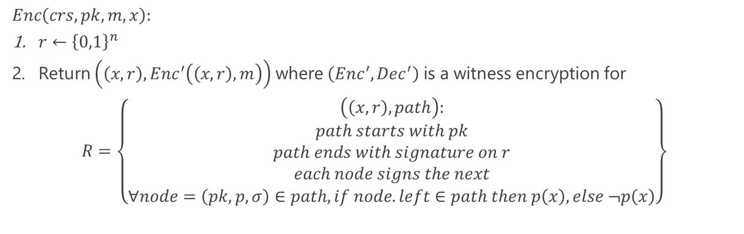





Construction [GZ20]
$$sk$$
$$p$$
$$σ←Sign\left( ,\left({pk}_{0},{pk}_{1}, \right)\right)$$
$$\left({sk}_{0},{pk}_{0}\right)$$
$$\left({sk}_{1},{pk}_{1}\right)$$
$$Enc\left(crs,pk,m,x\right):$$
$r←{\left\{0,1\right\}}^{n}$
Return $\left({\left(x,r\right),Enc}^{′}\left(\left(x,r\right),m\right)\right)$ where $\left({Enc}^{′},{Dec}^{′}\right)$ is a witness encryption for
$$R=\left\{\begin{aligned}\begin{aligned}\left(\left(x,r\right),path\right): \\ path starts with pk\end{aligned} \\ path ends with signature on r \\ each node signs the next \\ ∀node=\left(pk,p,σ\right)∈path, if node.left∈path then p\left(x\right), else ¬p\left(x\right)\end{aligned}\right\}$$
Notes:
We have to provide a valid path.
Security. If two adversaries manage to decrypt then, the corresponding simulators manage to provide valid paths for $\left(x,r\right)$. If the public keys in both paths are the same, then we break one shot signatures, because we signed the randomness with the same public key. If the paths are different, then consider the predicate of the last common node. If it is satisfied by $x$, then the left child signs two messages, otherwise the right child.

Slide 26





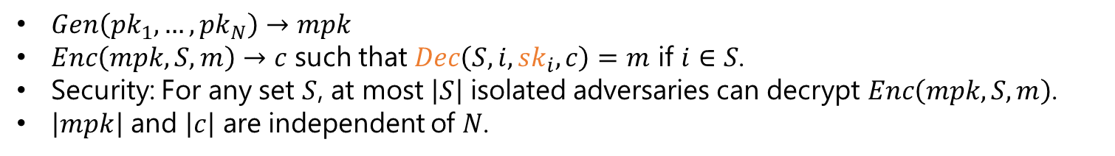



Unclonable Broadcast Encryption [GZ20]
$$pk_{1}$$
$$pk_{2}$$
$$pk_{3}$$
$$pk_{4}$$
$Gen\left(pk_{1},…,pk_{N}\right)→mpk$
$Enc\left(mpk,S,m\right)→c$ such that $Dec\left(S,i,{sk}_{i},c\right)=m$ if $i∈S$.
Security: For any set $S$, at most $\left|S\right|$ isolated adversaries can decrypt $Enc\left(mpk,S,m\right)$.
$\left|mpk\right|$ and $\left|c\right|$ are independent of $N$.
Notes:
Note to Mark.

Slide 27




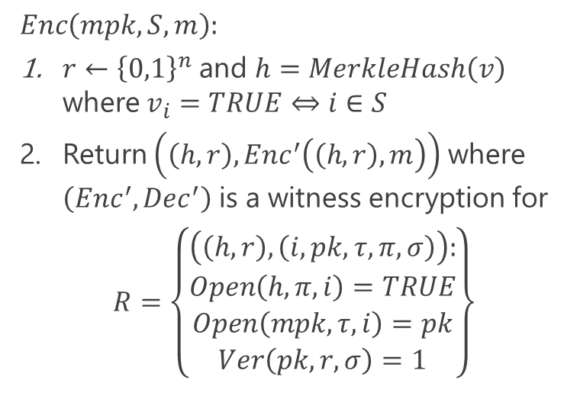



Construction [GZ20]
$$mpk=H\left(h_{0},h_{1}\right)=MerkleHash\left({pk}_{1},{pk}_{2},{pk}_{3},{pk}_{4}\right)$$
$$Enc\left(mpk,S,m\right):$$
$r←{\left\{0,1\right\}}^{n}$ and $h=MerkleHash\left(v\right)$ where $v_{i}=TRUE⇔i∈S$
Return $\left(\left(h,r\right),{Enc}^{′}\left(\left(h,r\right),m\right)\right)$ where $\left({Enc}^{′},{Dec}^{′}\right)$ is a witness encryption for
$$R=\left\{\begin{aligned}\begin{aligned}\left(\left(h,r\right),\left(i,pk,τ,π,σ\right)\right): \\ Open\left(h,π,i\right)=TRUE \\ Open\left(mpk,τ,i\right)=pk\end{aligned} \\ Ver\left(pk,r,σ\right)=1\end{aligned}\right\}$$
$$h_{0}=H\left({pk}_{1},{pk}_{2}\right)$$
$$h_{1}=H\left({pk}_{3},{pk}_{4}\right)$$
$${pk}_{1}$$
$${pk}_{2}$$
$${pk}_{3}$$
$${pk}_{4}$$
$${SK}_{2}=\left({sk}_{2},τ_{2}\right)$$
Notes:
The public keys are from a one-shot signature.
We witness encrypt message $m$ with respect to an instance $\left(h,r\right)$ and in order for the adversary to decrypt, it has to provide:
A proof $π$ that $i$ is in the set.
A proof $τ$ that $pk$ is the $i$th element in the Merkle tree of the master public key.
And finally, a signature on $r$ that is verified by $pk$.
Security: If there is an $i$ not in S, then collision on h.
If all I are in S, then by pigeonhole principle, two of them will be the same. Now for this i, if the public keys are the same then we break one-shot signatures. If they are different then collision on the mpk.

Slide 28
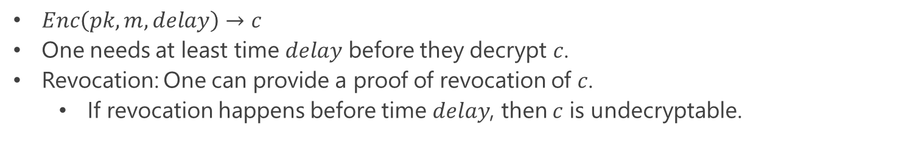
Time-Released Encryption [GZ20]
$Enc\left(pk,m,delay\right)→c$
One needs at least time $delay$ before they decrypt $c$.
Revocation: One can provide a proof of revocation of $c$.
  If revocation happens before time $delay$, then $c$ is undecryptable.
Construction: Witness Encryption + Delay Signatures.

Slide 29
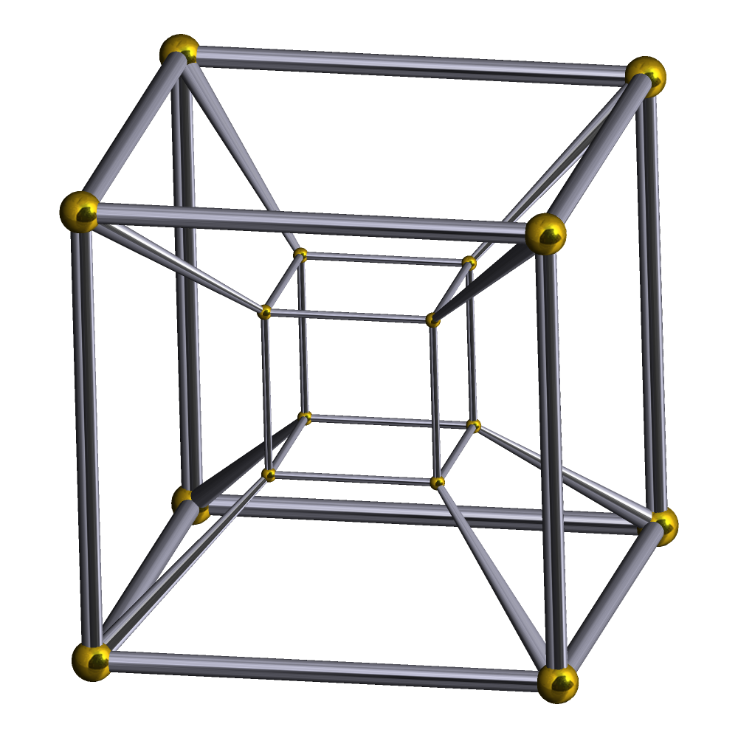
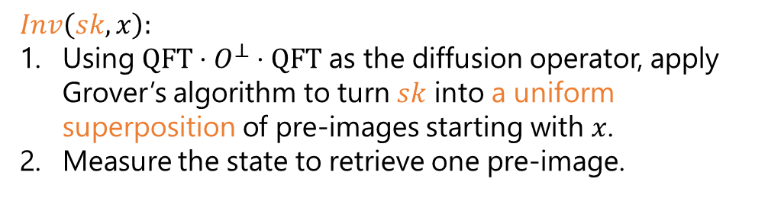

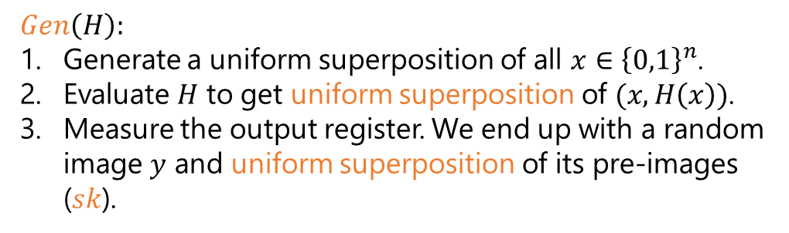
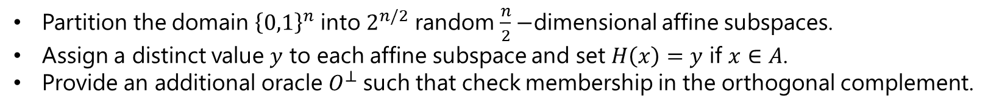

One-Shot Chameleon Relative to an Oracle (for $\left|x\right|=1$)
$$Gen\left(H\right):$$
Generate a uniform superposition of all $x∈{\left\{0,1\right\}}^{n}$.
Evaluate $H$ to get uniform superposition of $(x,H\left(x\right))$.
Measure the output register. We end up with a random image $y$ and uniform superposition of its pre-images ($sk$).
$$\left(1,1,1,1\right)$$
$$Inv\left(sk,x\right):$$
Using $QFT⋅O^{⊥}⋅QFT$ as the diffusion operator, apply Grover’s algorithm to turn $sk$ into a uniform superposition of pre-images starting with $x$.
Measure the state to retrieve one pre-image.
$$\left(0,0,0,0\right)$$
Partition the domain ${\left\{0,1\right\}}^{n}$ into $2^{n/2}$ random $\frac{n}{2}−$dimensional affine subspaces.
Assign a distinct value $y$ to each affine subspace and set $H\left(x\right)=y$ if $x∈A$.
Provide an additional oracle $O^{⊥}$ such that check membership in the orthogonal complement.

Slide 30
Related Literature
One-Shot Signatures and Applications to Hybrid Quantum/Classical Authentication – Ryan Amos, Marios Georgiou, Aggelos Kiayias, Mark Zhandry, 2020
Unclonable Decryption Keys – Marios Georgiou, Mark Zhandry, 2020
New Constructions for Quantum Money – Marios Georgiou, Iordanis Kerenidis, 2015
Cryptography with Disposable Backdoors – Kai-Min Chung, Marios Georgiou, Ching-Yi Lai, Vassilis Zikas, 2018
Quantum Lightning Never Strikes the Same State Twice – Mark Zhandry, 2017
Secure Software Leasing – Prabhanjan Ananth, Rolando La Placa, 2020
Uncloneable Quantum Encryption via Random Oracles – Anne Broadbent, Sebastien Lord, 2019
Quantum Copy-Protection from Hidden Subspaces – Scott Aaronson, Jiahui Liu, Ruizhe Zhang, 2020
Quantum Tokens for Digital Signatures – Shalev Ben-David, Or Sattath, 2016
Quantum Attacks on Classical Proof Systems: The Hardness of Quantum Rewinding – Andris Ambainis, Ansis Rosmanis, Dominique Unruh, 2014

Slide 31
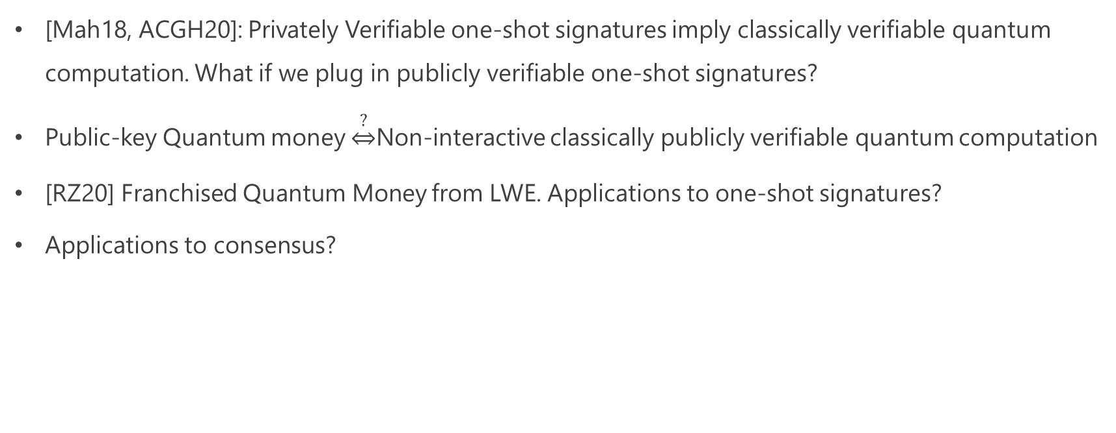
Open Problems
[Mah18, ACGH20]: Privately Verifiable one-shot signatures imply classically verifiable quantum computation. What if we plug in publicly verifiable one-shot signatures?
Public-key Quantum money $\underset{⇔}{?}$Non-interactive classically publicly verifiable quantum computation
[RZ20] Franchised Quantum Money from LWE. Applications to one-shot signatures?
Applications to consensus?
Notes:
Mahadev, FOCS 18 in a totally different context.
Alagic, Childs, Grilo, Hung

